Slide 1

Identifying Adverbs

Slide 2
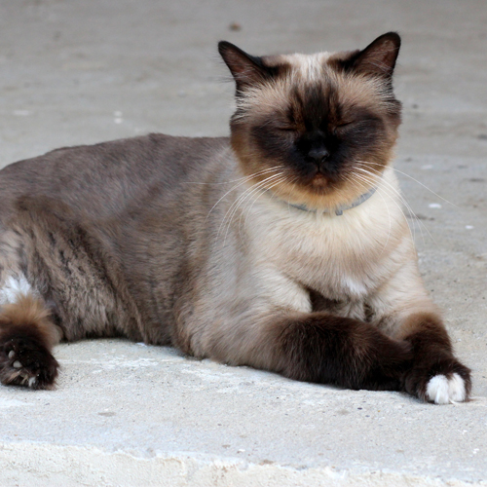
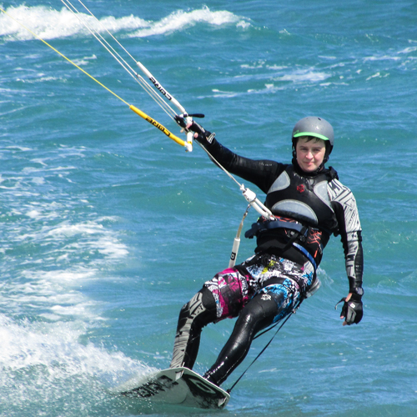
Adverbs
An adverb is a word or phrase that describes a verb.
Remember, a verb describes an action.
For example:
The cat lay lazily.
Gracefully, he glided.

Slide 3

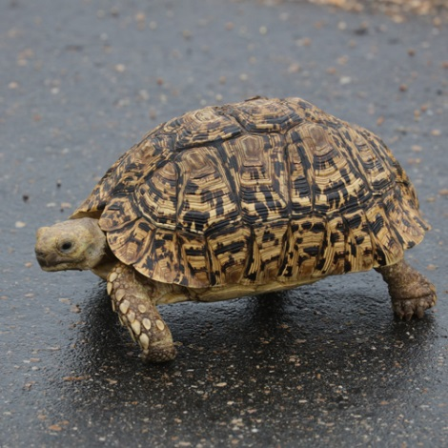
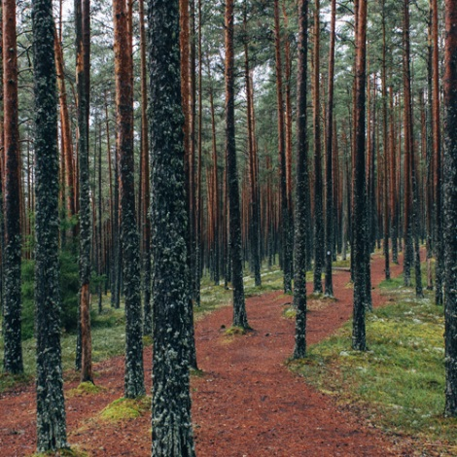
Types of Adverb
Adverbs can describe how things happen, the timing of something or the place where something happens.
time
how
place
Tonight we are seeing a firework display.
A tortoise walks slowly.
I walked here.

Slide 4



Time
Can you spot the ‘time’ adverbs in these sentences?
We should go home now.
I woke early.
The milkman delivers our milk daily.

Slide 5
Time
Can you spot the ‘time’ adverbs in these sentences?
verb
adverb
We should go home now.
I woke early.
The milkman delivers our milk daily.

Slide 6
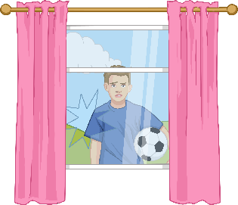
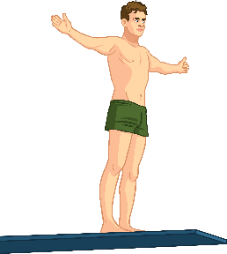
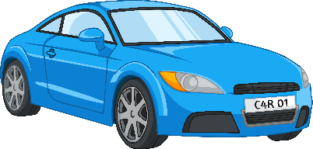
How
Can you spot the ‘how’ adverbs in these sentences?
I accidentally broke it.
Daringly, he jumped.
The car drove victoriously over the finish line.

Slide 7
How
Can you spot the ‘how’ adverbs in these sentences?
verb
adverb
I accidentally broke it.
Daringly, he jumped.
The car drove victoriously over the finish line.

Slide 8
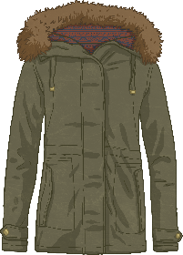
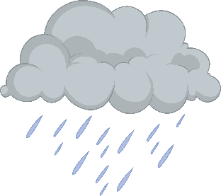

Place
Can you spot the ‘place’ adverbs in these sentences?
My coat is upstairs.
It was wet outside.
We didn’t go far.

Slide 9
Place
Can you spot the ‘place’ adverbs in these sentences?
verb
adverb
My coat is upstairs.
It was wet outside.
We didn’t go far.

Slide 10
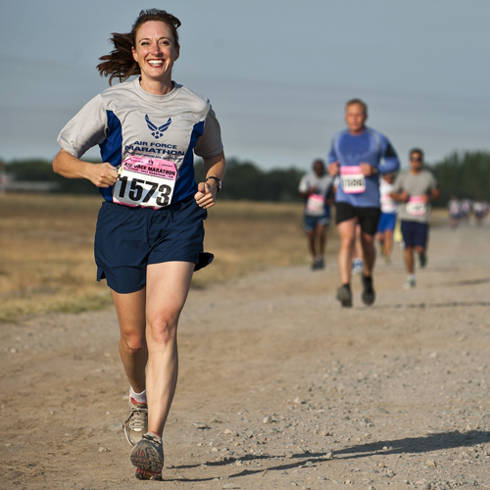
Modifying Other Adverbs
Adverbs can also modify other adverbs.
For example:
Claire finished the marathon extremely quickly.

Slide 11

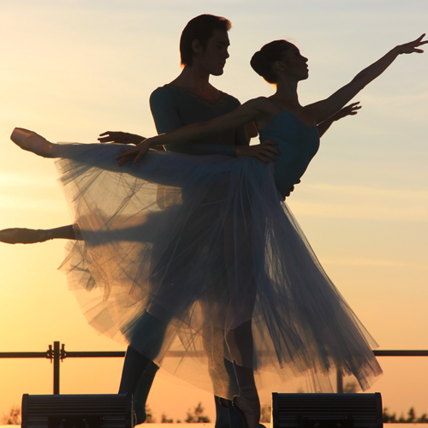
Modifying Other Adverbs
Can you identify the verbs and adverbs in these sentences?
There could be more than one!
There were daffodils growing densely everywhere.
They danced together
beautifully.

Slide 12
Modifying Other Adverbs
Can you identify the verbs and adverbs in these sentences?
There could be more than one!
verb
adverb
There were daffodils growing densely everywhere.
They danced together
beautifully.

Slide 13
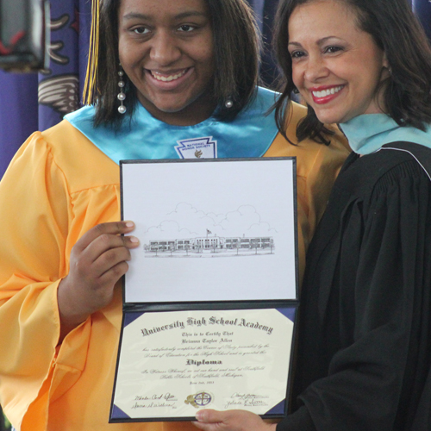

Modifying Adjectives
Sometimes adverbs modify an adjective (a describing word).
She must have been extremely clever.
The food was reasonably cheap.

Slide 14

Top Tips
Often, but not always, adverbs end in the ‘ly’ suffix.
For example, ‘beautifully’ or ‘quickly’.
It can be tricky to tell the difference between a place adverb and a
preposition (a word that describes the relationship between two nouns).
Remember, prepositions always describe a noun/object
and an adverb doesn’t describe an object but an action.

