Slide 1


Slide 3

1) One more than eight is ___
2) One less than 4 is ___
3) How many ants?
4) What number comes next? 7, 6, 5, ___

Slide 4
9
1) One more than eight is ___
2) One less than 4 is ___
3) How many ants?
4) What number comes next? 7, 6, 5, ___
3
6
4

Slide 6










Order objects
smallest
greatest
From to
greatest
smallest
From to

Slide 7



Order objects
A
B
C
smallest
greatest
From to
Cake A has candles.
5
3
Cake B has candles.
8
Cake C has candles.

Slide 8






I want the smallest number of chocolate chips
Have a think
I want the greatest number of chocolate chips
Which one will Dora choose?
Which one will Whitney choose?
A
B
A
B
C

Slide 9
Have a go at questions 1 and 2 on the worksheet

Slide 10

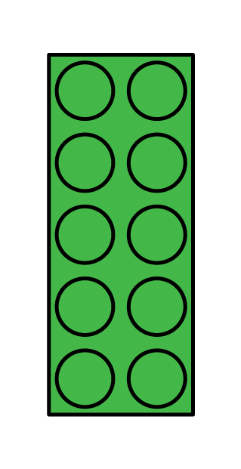
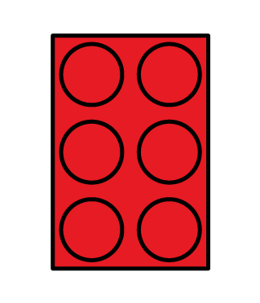
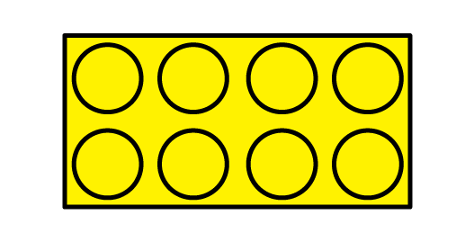
I have put these
in order…
greatest
smallest
From to

Slide 11
Have a think
Order from smallest to greatest
What could the missing amount be?

Slide 12
Have a think
Order from smallest to greatest
What could the missing amount be?

Slide 13
Have a go at the rest of the worksheet

