Slide 1


Slide 3




Which represents more?
or
or
or

Slide 4
Which represents more?
or
or
or

Slide 6




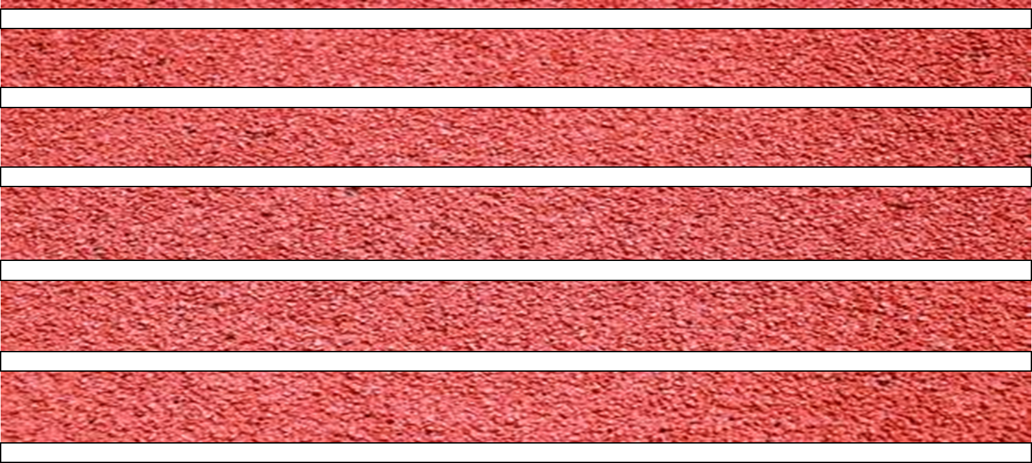

0
3
1
2
Ready…
Steady…
GO!

Slide 7




55
35
Tommy won!
Have a think

Slide 8


55
35

Slide 9
60
27
Have a think

Slide 10
81
49
Have a think

Slide 11
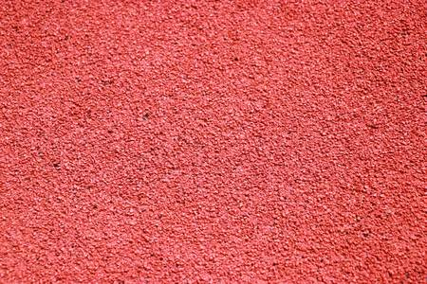


Ready…
Steady…
GO!
Have a go

Slide 12



22
10
5
$$>$$

Slide 13

75
5
70
$$=$$
Have a think

Slide 14
Have a go at questions 1 - 5 on the worksheet

Slide 15






3rd
2nd
1st
48
$<$
?
$<$
53
49
50
51
52

Slide 16
Have a go at the rest of the worksheet

