Slide 1


Slide 3




Can you match the representations
with the numbers?
2
14
15
20

Slide 4
Can you match the representations
with the numbers?
2
14
15
20

Slide 5


Slide 6

1 | 2 | 3 | 4 | 5 | 6 | 7 | 8 | 9 | 10
11 | 12 | 13 | 14 | 15 | 16 | 17 | 18 | 19 | 20
21 | 22 | 23 | 24 | 25 | 26 | 27 | 28 | 29 | 30
0 | 1 | 2 | 3 | 4 | 5 | 6 | 7 | 8 | 9 | 10

Slide 7






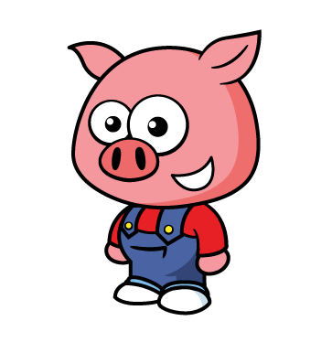


What can we count in 2s?
Have a think

Slide 8


0 | 1 | 2 | 3 | 4 | 5 | 6 | 7 | 8 | 9 | 10

Slide 9
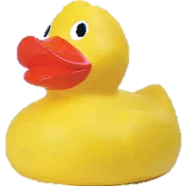
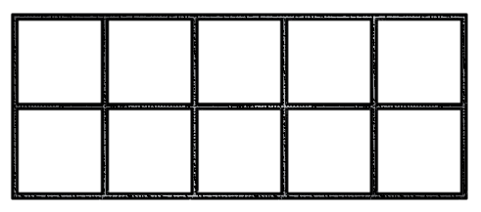
How many ducks?
Have a think

Slide 10
Have a go at question
1 on the worksheet

Slide 11

1 | 2 | 3 | 4 | 5 | 6 | 7 | 8 | 9 | 10
11 | 12 | 13 | 14 | 15 | 16 | 17 | 18 | 19 | 20
21 | 22 | 23 | 24 | 25 | 26 | 27 | 28 | 29 | 30
How many mittens?
There are 20 mittens.
Notes:
You have been practicing counting in 2’s to 20
Let’s practice

Slide 12

Have a think
Can you count on in 2s?
0 | 2 | 4 | 6 | 8 | 10 | 12 | 14 | 16 | 18 | 20
There are 18 eyes.

Slide 13



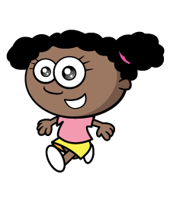

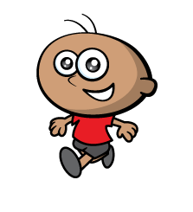
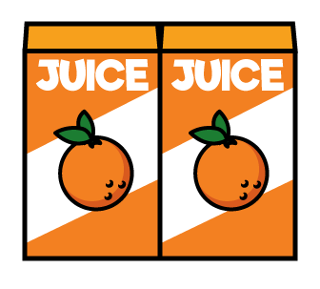
0 | 2 | 4 | 6 | 8 | 10 | 12 | 14 | 16 | 18 | 20
Notes:
Faster, pairs

Slide 14

Counting in 2s
1 | 2 | 3 | 4 | 5 | 6 | 7 | 8 | 9 | 10
11 | 12 | 13 | 14 | 15 | 16 | 17 | 18 | 19 | 20
21 | 22 | 23 | 24 | 25 | 26 | 27 | 28 | 29 | 30
31 | 32 | 33 | 34 | 35 | 36 | 37 | 38 | 39 | 40
41 | 42 | 43 | 44 | 45 | 46 | 47 | 48 | 49 | 50
36
There are __ bread rolls?
Notes:
All in columns Have 2,4,6,8, or 0 Skips a column

Slide 15
Counting in 2s
1 | 2 | 3 | 4 | 5 | 6 | 7 | 8 | 9 | 10
11 | 12 | 13 | 14 | 15 | 16 | 17 | 18 | 19 | 20
21 | 22 | 23 | 24 | 25 | 26 | 27 | 28 | 29 | 30
31 | 32 | 33 | 34 | 35 | 36 | 37 | 38 | 39 | 40
41 | 42 | 43 | 44 | 45 | 46 | 47 | 48 | 49 | 50
44
46
48
50
What is missing?
50 | 48 | 46 | 44
50 | 48 | 46 | ?
42 | 40 | ? | 36
42 | 40 | 38 | 36
Notes:
All in columns Have 2,4,6,8, or 0 Skips a column

Slide 16
Have a go at the rest of the worksheet

