Slide 1


Slide 3







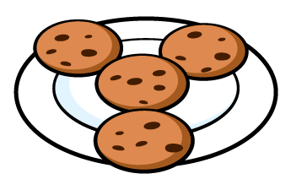

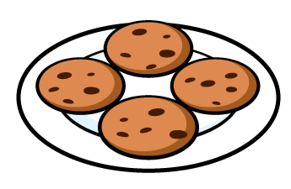
Are the groups equal or not equal?
2) Are the groups equal or not equal?
3) Are the groups equal or not equal?

Slide 4
Are the groups equal or not equal?
2) Are the groups equal or not equal?
3) Are the groups equal or not equal?
not equal
equal
equal

Slide 6



The dog is the whole.
Which of these images
is a part?

Slide 7





The fruit basket is the whole.
Which of these images is a part?

Slide 8



Slide 10


Amir and Ron each build a tower of 4 cubes.
They break their towers into 2 parts
Amir has made equal parts.
Ron has made unequal parts.

Slide 11

Task 1: Build a tower of 8 cubes
How many ways can you break your tower into equal parts?
How many ways can you break your tower into unequal parts?
Have a think

Slide 12
Task 2: Equal parts
You will need some paper cut into squares.
How many different ways can you fold or cut the squares into 2 equal parts?
What about 4 equal parts?
Have a think

Slide 13
Task 2: Equal parts

Slide 14




Here is a number shape 6
Whitney builds 6 again using 2 parts.
Are the parts equal or unequal?

Slide 15



Task 3: How many ways can you build or draw 6?
Using 2 parts Using more than 2 parts
Using equal parts Using unequal parts
Have a think

Slide 16
Task 4: 20 counters
Count out 20 counters or other small objects.
How many different ways can you organise your counters into equal parts and unequal parts?
Have a think

Slide 17
Task 4: 20 counters
Count out 20 counters or other small objects.
How many different ways can you organise your counters into equal parts and unequal parts?

